Slide 1
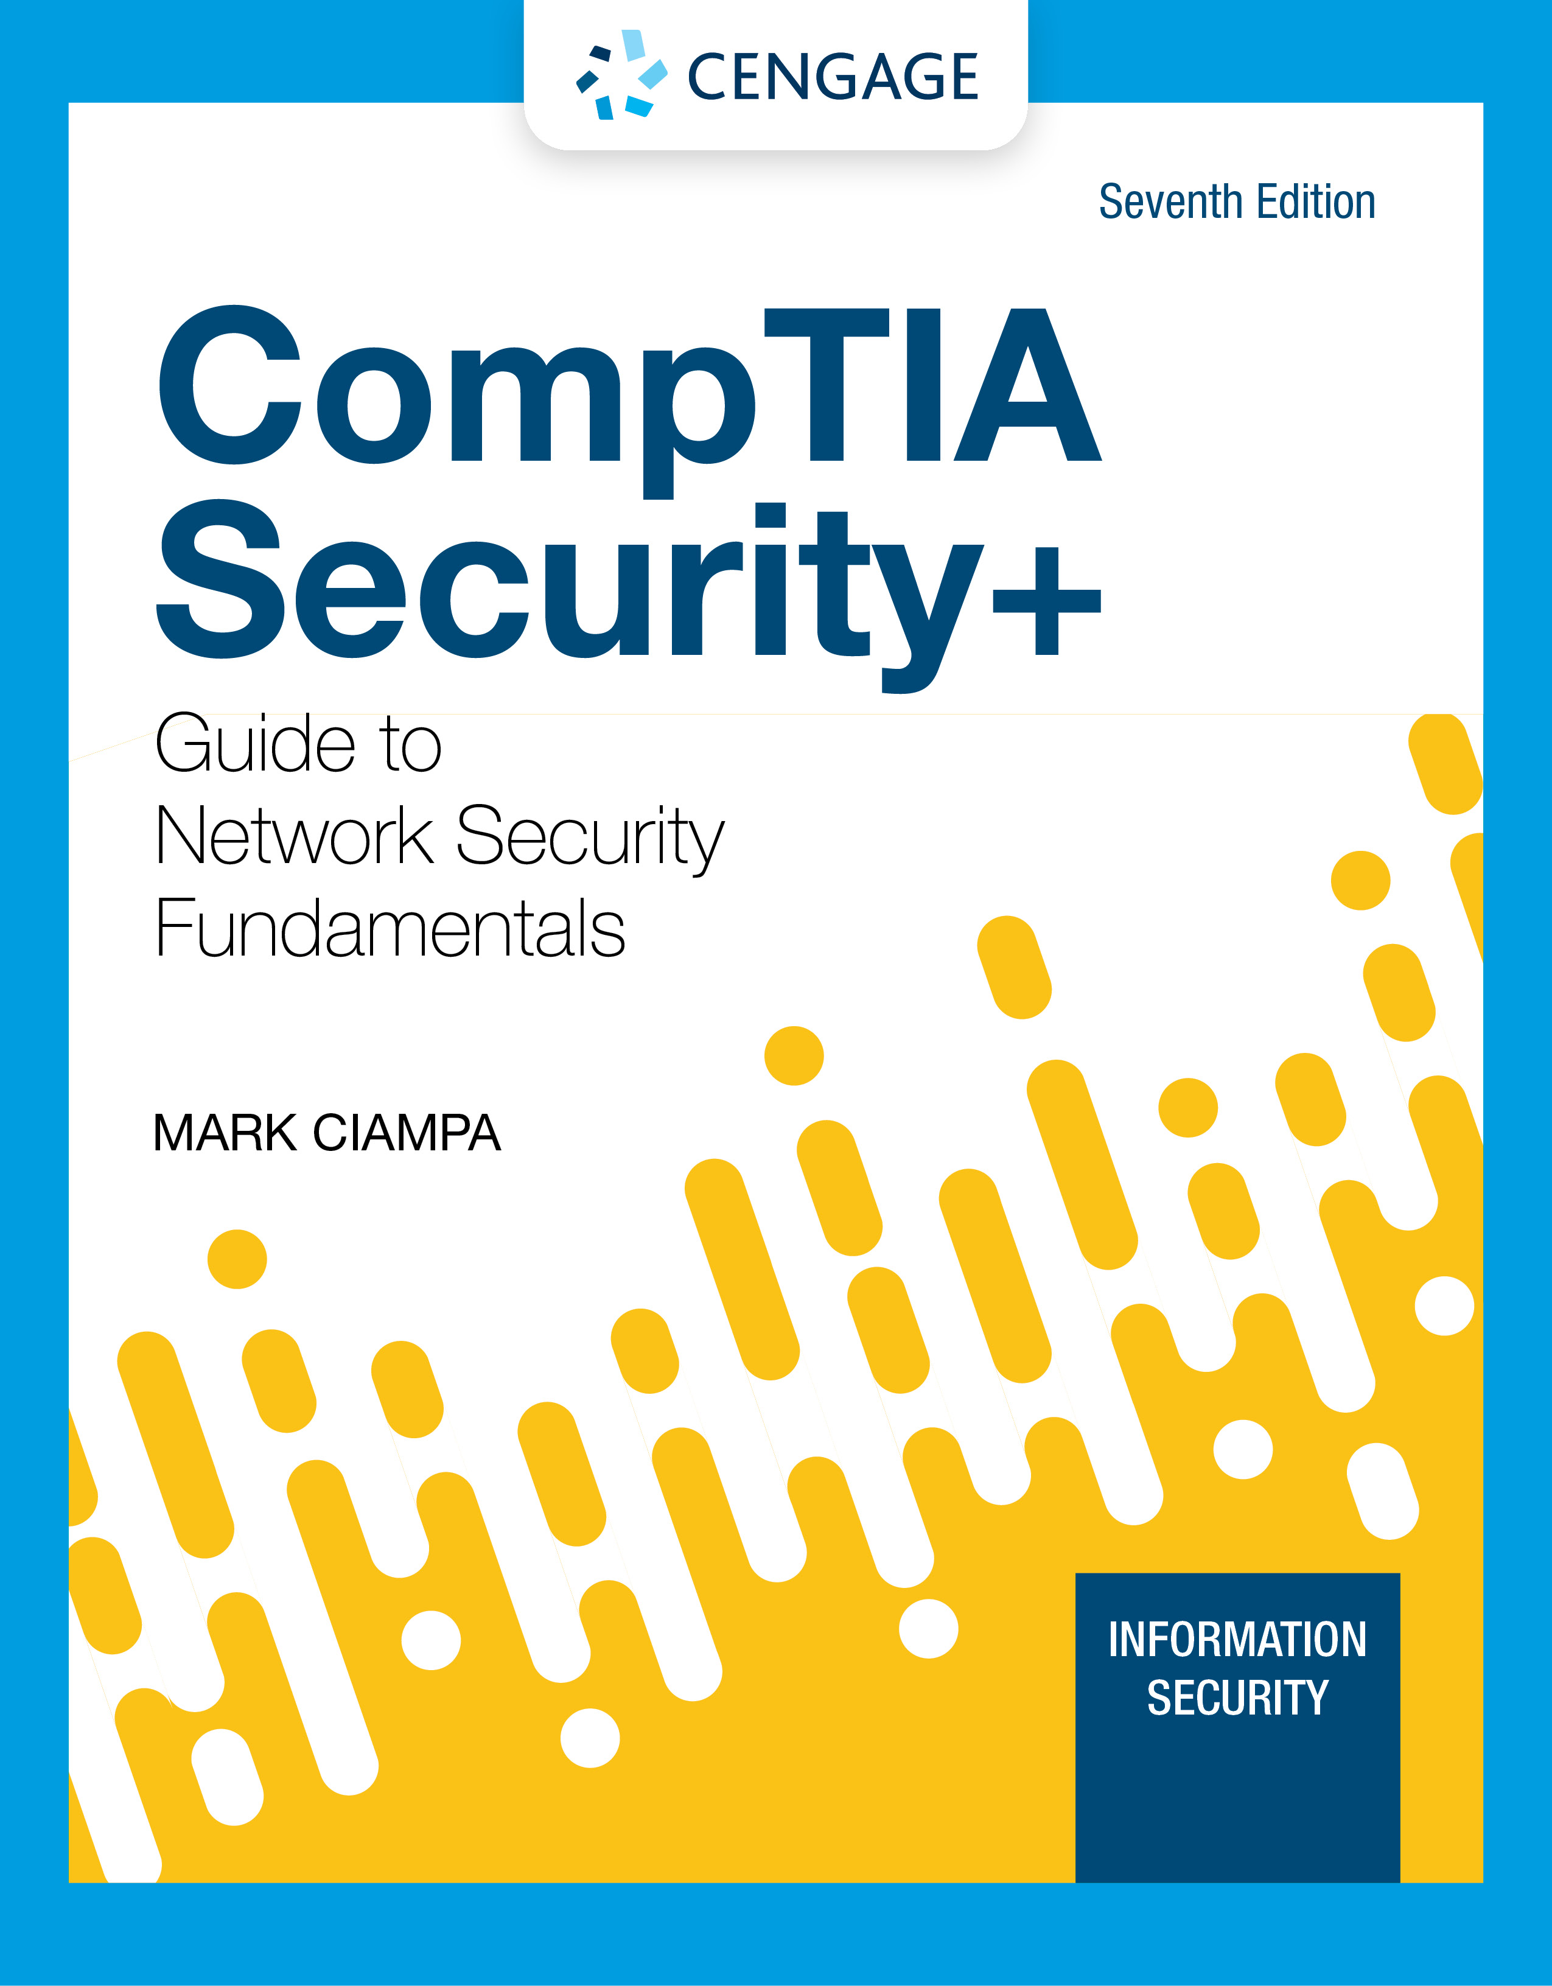
Module 6: Basic Cryptography
CompTIA Security+ Guide
to Network Security Fundamentals, 7th Edition

Slide 2
Module Objectives
By the end of this module, you should be able to:
1. Define cryptography
2. Describe hash, symmetric, and asymmetric cryptographic algorithms
3. Explain different cryptographic attacks
4. List the various ways in which cryptography is used

Slide 3
Defining Cryptography
Defining cryptography involves understanding what it is and how it is used
It also involves knowing the limitations of cryptography

Slide 4
What is Cryptography? (1 of 5)
Cryptography
Scrambling information so it cannot be read
Transforms information into secure form so unauthorized persons cannot access it
Steganography
Hides the existence of data
An image, audio, or video file can contain hidden messages embedded in the file
Achieved by dividing data and hiding in unused portions of the file
May hide data in the file header fields that describe the file, between sections of the metadata (data used to describe the content or structure of the actual data)

Slide 5
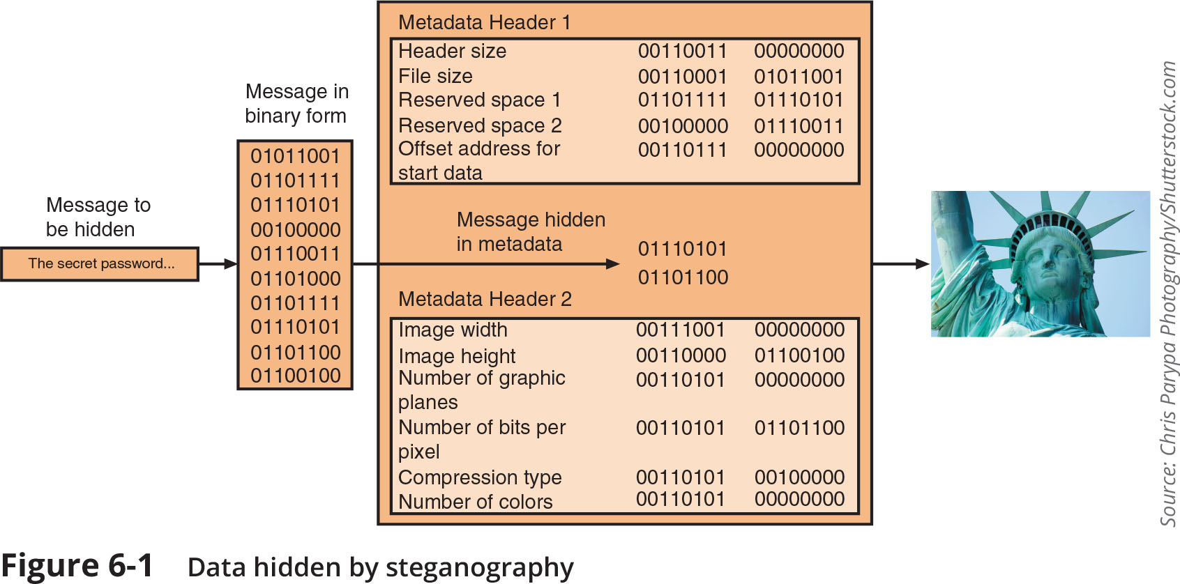
What is Cryptography? (2 of 5)
Figure 6-1 Data hidden by steganography

Slide 6
What is Cryptography? (3 of 5)
Encryption is the process of changing original text into a secret message using cryptography
Changing the secret message back to its original form is known as decryption
Plaintext is unencrypted data to be encrypted or is the output of decryption
Ciphertext is the scrambled and unreadable output of encryption
Cleartext data is data stored or transmitted without encryption
Plaintext data is input into a cryptographic algorithm (also called a cipher)
It consists of procedures based on a mathematical formula used to encrypt and decrypt the data

Slide 7
What is Cryptography? (4 of 5)
A key is a mathematical value entered into the algorithm to produce ciphertext
The reverse process uses the key to decrypt the message
A substitution cipher substitutes one character for another
One type is a ROT13, in which the entire alphabet is rotated 13 steps (A=N)
An XOR cipher is based on the binary operation eXclusive OR that compares two bits
If the bits are different, a 1 is returned, if they are identical, a 0 is returned

Slide 8
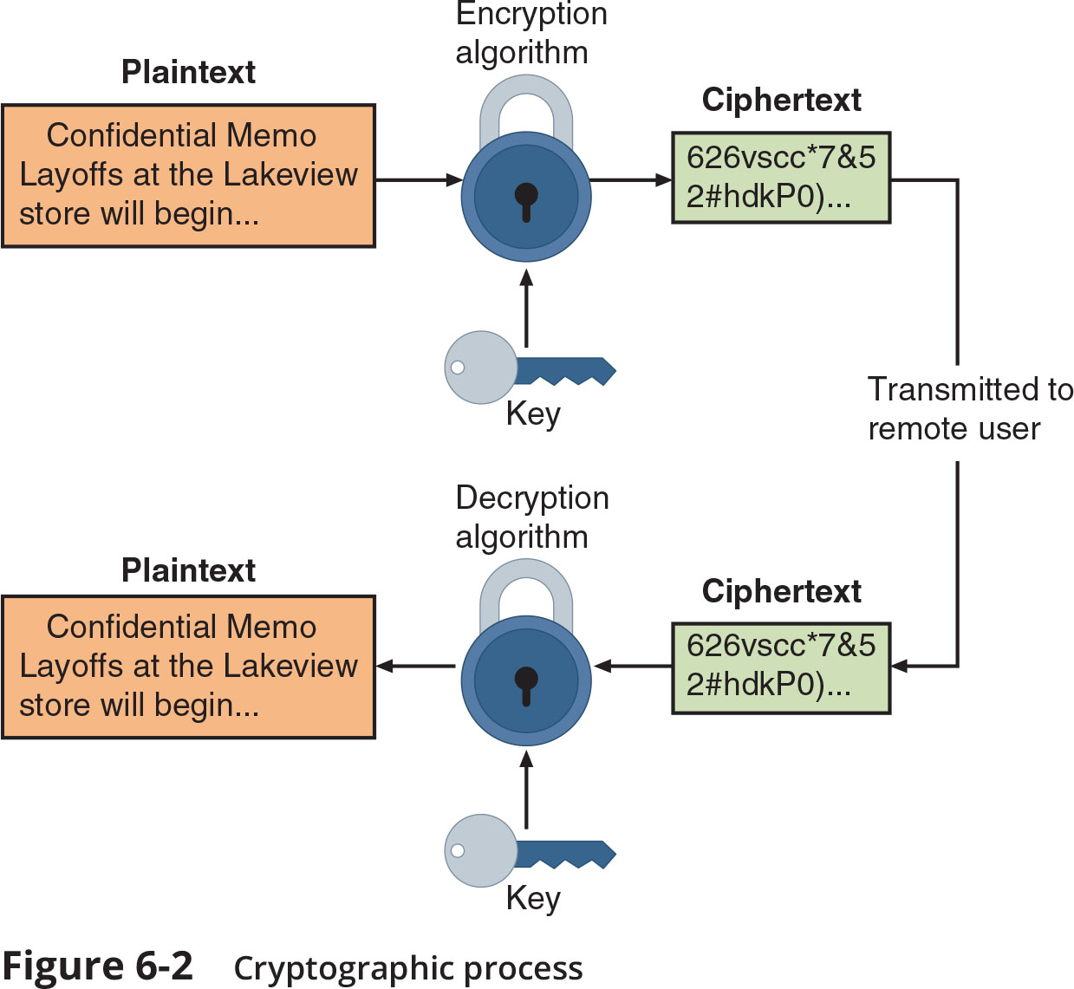
What is Cryptography? (5 of 5)
Figure 6-2 Cryptographic process

Slide 9
Cryptography Use Cases (1 of 2)
Cryptography can provide several basic protections
Confidentiality ensures only authorized parties can view it
Integrity ensures information is correct and unaltered
Authentication ensures sender can be verified through cryptography
Nonrepudiation proves that a user performed an action
Obfuscation is making something obscure or unclear
Security through obscurity
An approach in security where virtually any system can be made secure as long as outsiders are unaware of it or how it functions

Slide 10
Cryptography Use Cases (2 of 2)
Cryptography can provide protection to data as that data resides in any of three states:
Data in processing (also called data in use) is data actions being performed by “endpoint devices”
Data in transit are actions that transmit the data across a network
Data at rest is data that is stored on electronic media

Slide 11
Limitations of Cryptography (1 of 2)
The number of small electronic devices (low-power devices) has grown significantly
These devices need to be protected from threat actors
Applications that require extremely fast response times also face cryptography limitations
Resource vs. security constraint is a limitation in providing strong cryptography due to the tug-of-war between available resources (time and energy) and the security provided by cryptography
It is important that there be high resiliency in cryptography
High resiliency is the ability to quickly recover from these resource vs. security constraints

Slide 12
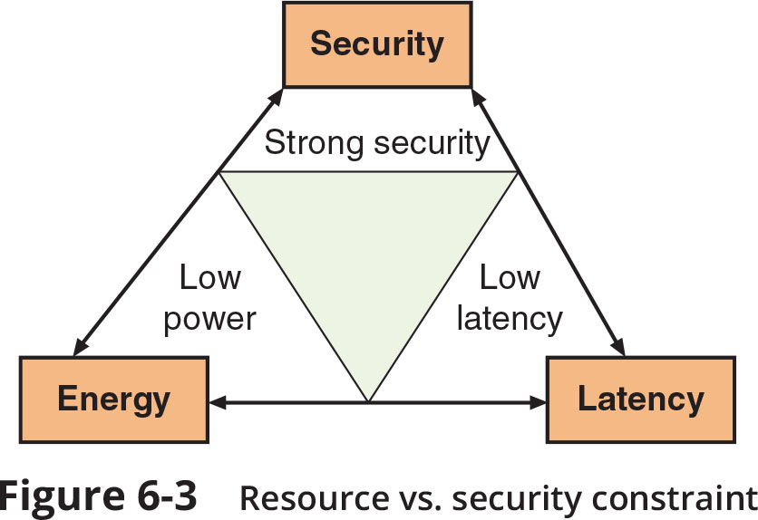
Limitations of Cryptography (2 of 2)
Figure 6-3 Resource vs. security constraint

Slide 13
Knowledge Check Activity 1
Which of the following is a term that proves that a user performed an action with a computer or on data?
a. Confidentiality
b. Nonrepudiation
c. Obfuscation
d. Authentication

Slide 14
Knowledge Check Activity 1: Answer
Which of the following is a term that proves that a user performed an action with a computer or on data?
Answer: b. Nonrepudiation
Repudiation means denial. Nonrepudiation is the inability to deny, so in information technology, nonrepudiation is the process of pricing that a user performed an action such as creating a file or sending an email.

Slide 15
Cryptographic Algorithms
A fundamental difference in cryptographic algorithms is the amount of data processed at a time
Stream cipher - takes one character and replaces it with another
Block cipher - manipulates an entire block of plaintext at one time
Sponge function - takes as input a string of any length and returns a string of any requested variable length
Three categories of cryptographic algorithms
Hash algorithms
Symmetric cryptographic algorithms
Asymmetric cryptographic algorithms

Slide 16
Hash Algorithms (1 of 3)
Hash algorithm creates a unique “digital fingerprint” of a set of data and is commonly called hashing
This fingerprint, called a digest (sometimes called a message digest or hash), represents the contents
Is primarily used for comparison purposes
Hashing is intended to be one way in that its digest cannot be reversed to reveal the original set of data
Secure hashing algorithm characteristics:
Fixed size - short and long data sets have the same size hash
Unique - two different data sets cannot produce the same hash
Original - data set cannot be created to have a predefined hash
Secure - resulting hash cannot be reversed to determine original plaintext

Slide 17
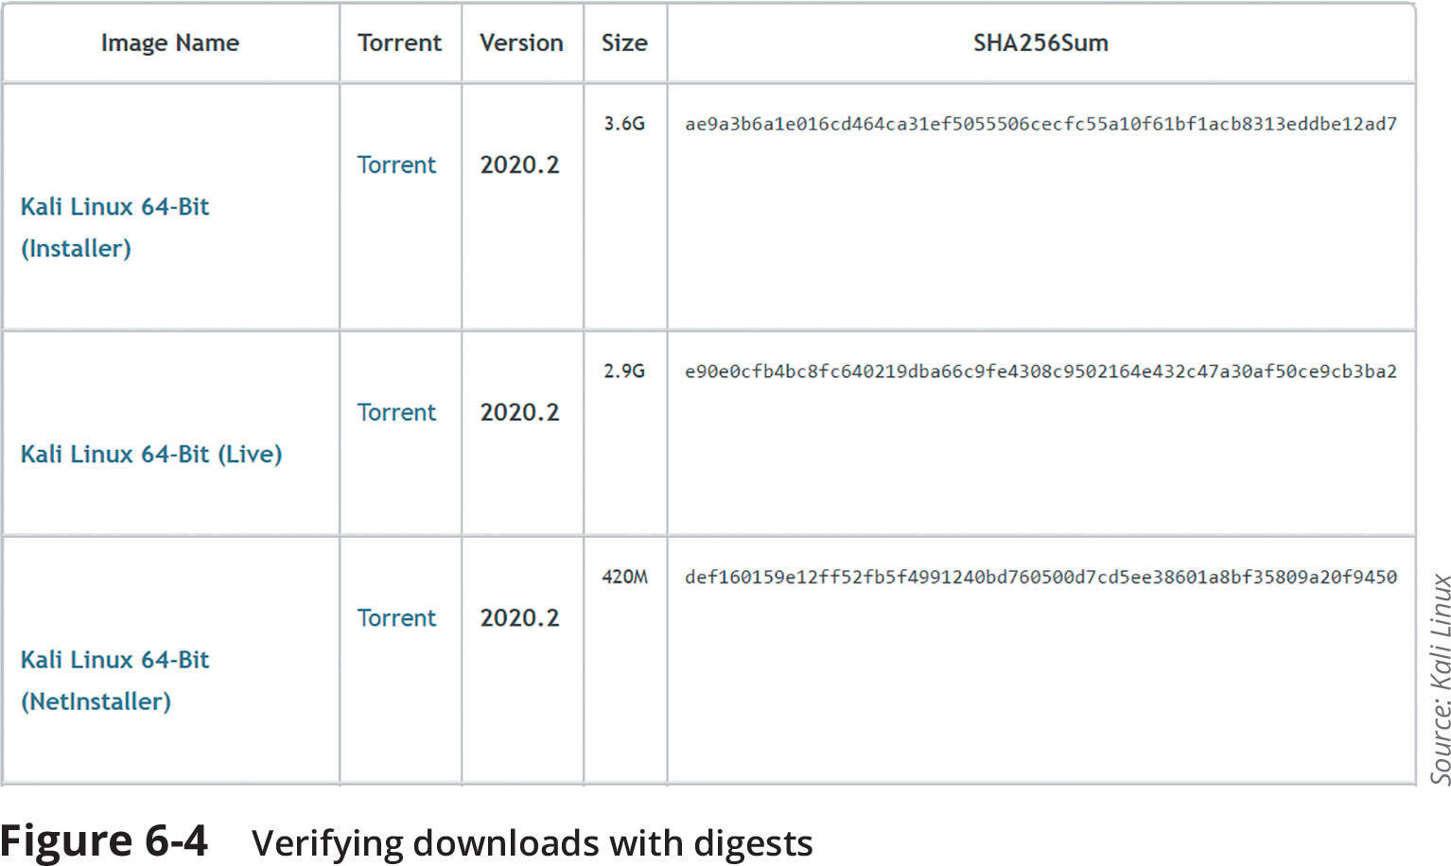
Hash Algorithms (2 of 3)
Figure 6-4 Verifying downloads with digests

Slide 18
Hash Algorithms (3 of 3)
Message Digest (MD) is one of the earliest family of hash algorithms
Most well-known of the MD hash algorithms is MD5
Some security experts recommend using a more secure hash algorithm
Secure Hash Algorithm (SHA)
SHA-2 is currently considered to be a secure hash
SHA-3 was announced as a new standard in 2015 and may be suitable for low-power devices
Race Integrity Primitives Evaluation Message Digest (RIPEMD)
The primary design feature is two different and independent parallel chains of computation, the results are combined at end of process
There are several version of RIPEMD
RIPEMD-128, RIPEMD-256, and RIPEMD-320

Slide 19
Symmetric Cryptographic Algorithms (1 of 2)
Symmetric cryptographic algorithms use the same single key to encrypt and decrypt a document
Original cryptographic algorithms were symmetric
Also called private key cryptography (the key is kept private between sender and receiver)
Common algorithms include:
Data Encryption Standard (DES)
Triple Data Encryption Standard (3DES)
Advanced Encryption Standard (AES)
Rivest Cipher (RC)
Blowfish

Slide 20
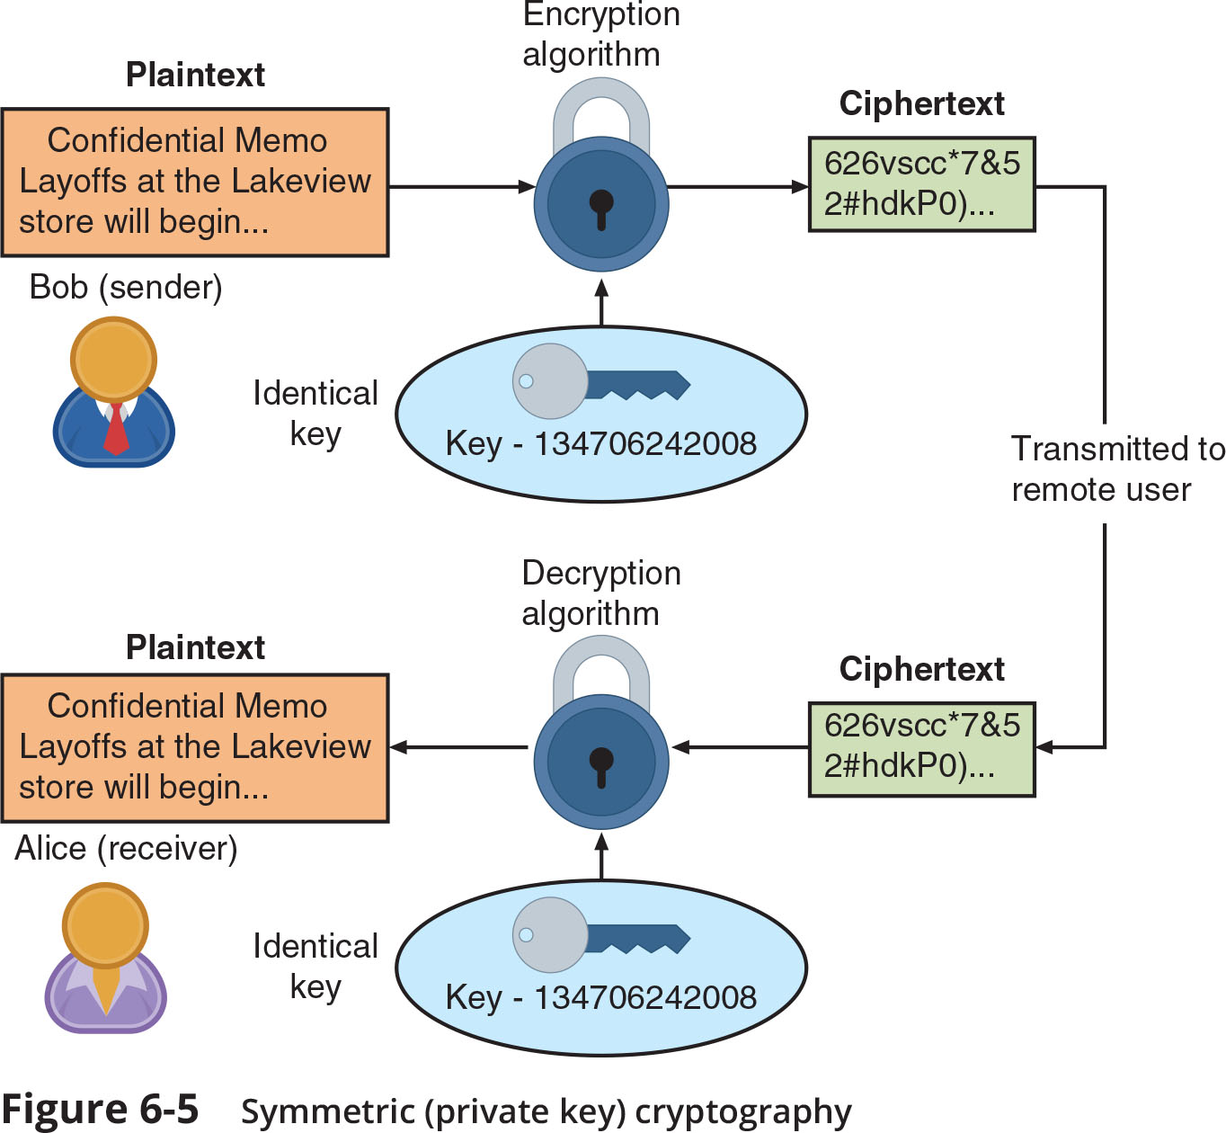
Symmetric Cryptographic Algorithms (2 of 2)
Figure 6-5 Symmetric (private key) cryptography

Slide 21
Asymmetric Cryptographic Algorithms (1 of 6)
The primary weakness of symmetric algorithms: distributing and maintaining a secure single key among multiple users distributed geographically poses challenges
Asymmetric cryptographic algorithms use two mathematically related keys
Also known as public key cryptography
Public key available to everyone and freely distributed
Private key known only to individual to whom it belongs
Important principles
Key pairs
Public key
Private key
Both directions - keys can work in both directions

Slide 22
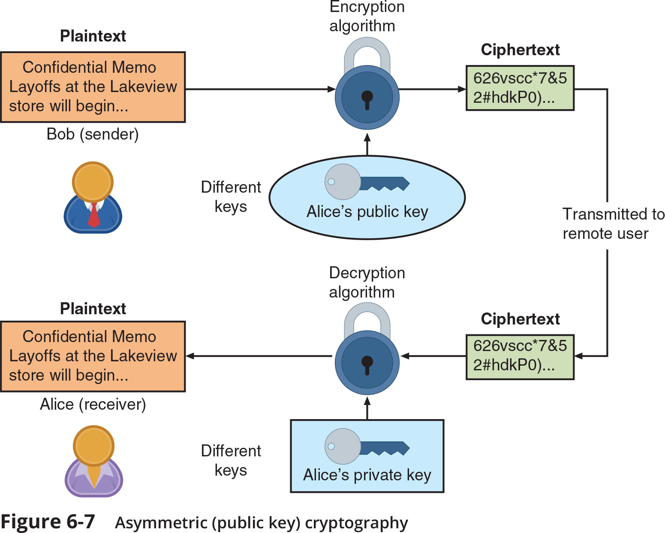
Asymmetric Cryptographic Algorithms (2 of 6)
Figure 6-7 Asymmetric (public key) cryptography

Slide 23
Asymmetric Cryptographic Algorithms (3 of 6)
RSA
Published in 1977
Multiplies two large prime numbers
The basis of RSA encryption security if factoring
Elliptic curve cryptography (ECC)
Users share one elliptic curve and one point on the curve
Uses less computing power than prime number-based asymmetric cryptography
Key sizes are smaller
Considered as an alternative for prime-number-based asymmetric cryptography for mobile and wireless devices

Slide 24
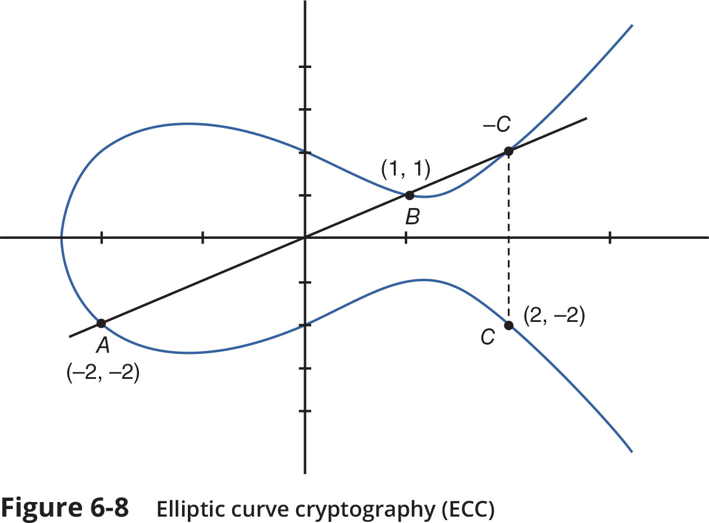
Asymmetric Cryptographic Algorithms (4 of 6)
Figure 6-8 Elliptic curve cryptography (ECC)

Slide 25
Asymmetric Cryptographic Algorithms (5 of 6)
Digital Signature Algorithm (DSA)
Creates a digital signature - an electronic verification of the sender
A digital signature can:
Verify the sender
Prevent sender from disowning the message
Prove message integrity
Key Exchange
There are different solutions for a key exchange that occurs within the normal communications channel (in-band) of cryptography:
Diffie-Hellman (DH)
Diffie-Hellman Ephemeral (DHE)
Elliptic Curve Diffie-Hellman (ECDH)
Perfect forward secrecy

Slide 26
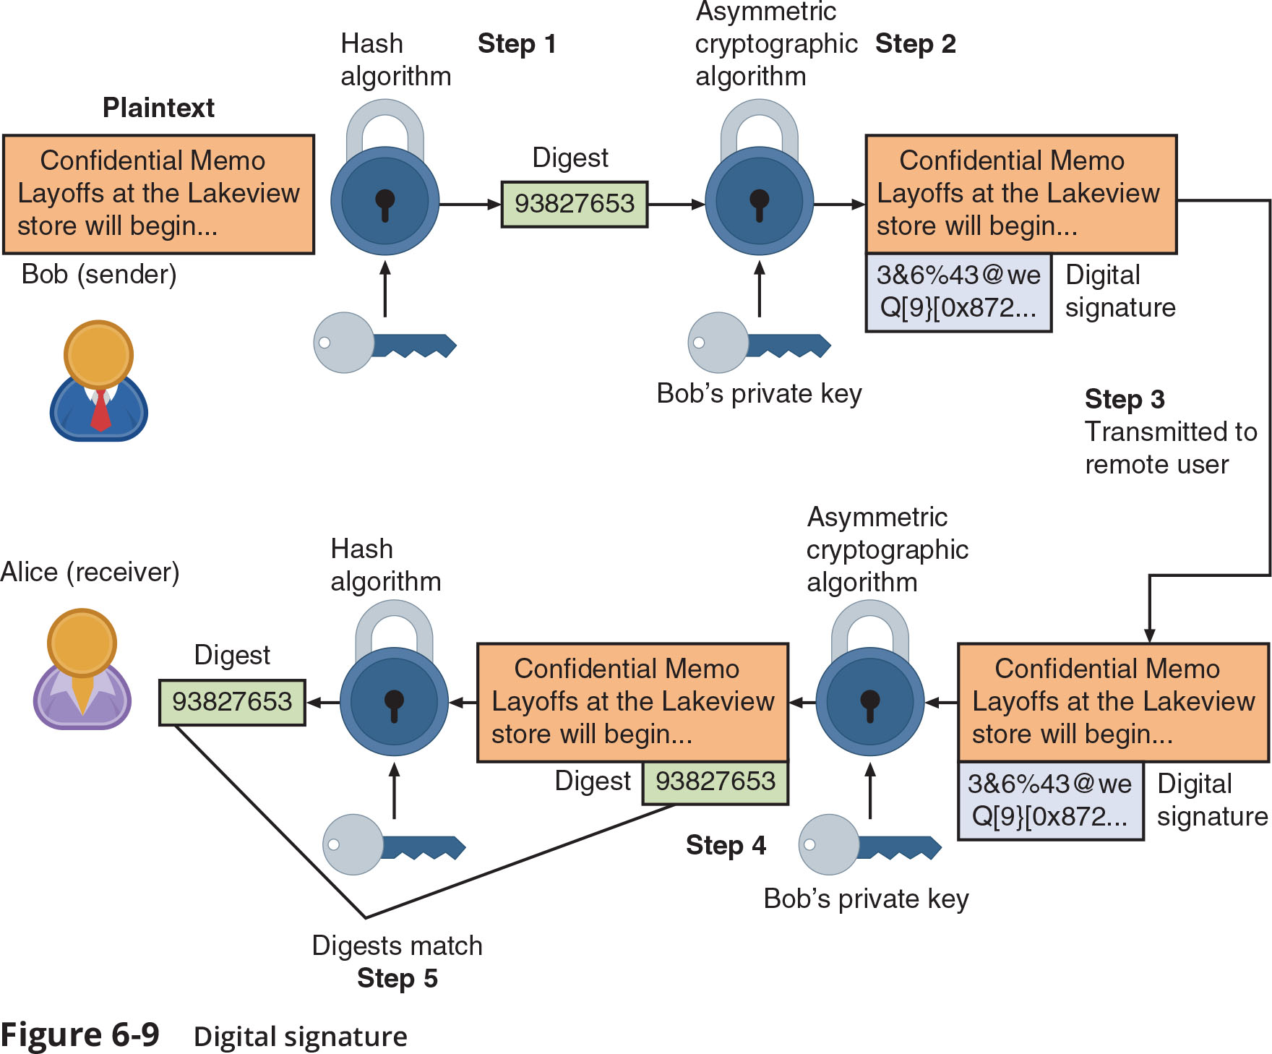
Asymmetric Cryptographic Algorithms (6 of 6)
Figure 6-9 Digital signature

Slide 27
Knowledge Check Activity 2
Which of the following is a function of a digital signature?
a. Provides authorization
b. Encrypts transmitted data
c. Decrypts transmitted data
d. Proves message integrity

Slide 28
Knowledge Check Activity 2: Answer
Which of the following is a function of a digital signature?
Answer: d. Proves message integrity
A digital signature can verify the sender of data, prevent a sender from disowning a message, and prove message integrity.

Slide 29
Cryptographic Attacks and Defenses
Cryptography remains under attack by threat actors for any vulnerabilities
The new field of quantum cryptography defenses can aid in making cryptography more secure

Slide 30
Attacks on Cryptography (1 of 2)
Two of the most common cryptography attacks are algorithm attacks and collision attacks
Algorithm Attacks
Methods attackers can use to circumvent strong algorithms:
Known ciphertext attacks
Statistical tools can be used to attempt to discover a pattern in the ciphertexts, which can then be used to reveal the plaintext or key
Downgrade attacks
A threat actor forces the system to abandon the current higher security mode of operation and instead “fall back” to implementing an older and less secure mode
Attacks based on misconfigurations
Selecting weak algorithms should be avoided since they are no longer secure

Slide 31
Attacks on Cryptography (2 of 2)
Collision Attacks
When two files have the same digest this is known as a collision
A collision attack is an attempt to find two input strings of a hash function that produce the same hash result
Birthday attack
Based on the birthday paradox, which says that for there to be a 50 percent chance that someone in a given room shares your birthday, 23 people would need to be in the room

Slide 32
Quantum Cryptographic Defenses
Quantum cryptography takes advantage of quantum computing for increasing cybersecurity
One subcategory of quantum cryptography is quantum communication or secure telecommunications
Users in a quantum communication exchange can easily detect eavesdroppers
Quantum computing also has a drawback for cybersecurity
A single quantum computer could perform factoring by using hundreds of atoms in parallel to quickly factor huge numbers, rendering all current asymmetric cryptographic algorithms useless

Slide 33
Knowledge Check Activity 3
Which type of cryptography attack attempts to find tow input strings of a hash function that produce the same hash result?
a. Downgrade attack
b. Birthday attack
c. Ciphertext attack
d. Algorithm attack

Slide 34
Knowledge Check Activity 3: Answer
Which type of cryptography attack attempts to find tow input strings of a hash function that produce the same hash result?
Answer: b. Birthday attack
A birthday attack is a type of collision attack based on the birthday paradox which states that there is a 50% chance of any two people sharing a birthday if there are only 23 people in the room.

Slide 35
Using Cryptography
Cryptography can be applied through:
Software
Hardware
A relatively new technology known as block-chain uses cryptography as its basis

Slide 36
Encryption through Software (1 of 2)
File and File System Cryptography
Encryption software can be used to encrypt or decrypt files one-by-one (a cumbersome process)
Protecting groups of files can take advantage of the OS’s file system
Third-party software tools available for encryption include GNU Privacy Guard (GNuPG), AxCrypt, Folder Lock, and VeraCrypt
Operating System Encryption
Microsoft Windows Encrypting File System (EFS) is a cryptography system for Windows
EFS uses NTFS file system
Tightly integrated with the file system
Encryption and decryption are transparent to the user

Slide 37
Encryption through Software (2 of 2)
Full Disk Encryption (FDE)
FDE protects all data on a hard drive
Example: BitLocker drive encryption software that is included in Microsoft Windows
BitLocker encrypts the entire system volume, including the Windows Registry
Prevents attackers from accessing data by booting from another OS or placing the hard drive in another computer

Slide 38
Hardware Encryption (1 of 3)
Software encryption can be subject to attacks to exploit its vulnerabilities
Cryptography can be embedded in hardware
Provides higher degree of security
Can be applied to USB devices and standard hard drives
Hardware encryption options include:
Trusted platform module
Hardware security module

Slide 39
Hardware Encryption (2 of 3)
USB device encryption
Encrypted hardware-based flash drives can be used
Will not connect a computer until correct password has been provided
All data copied to the drive is automatically encrypted
Tamper-resistant external cases
Administrators can remotely control and track activity on the devices
Stolen drives can be remotely disabled
Self-Encrypting Drives (SEDs)
Self-encrypting hard disk drives protect all files stored on them
The drive and host device perform authentication process during initial power up
If authentication fails, the drive can be configured to deny access or even delete encryption keys so all data is permanently unreadable

Slide 40
Hardware Encryption (3 of 3)
Hardware Security Module (HSM)
HSM is a removable external cryptographic device
It includes an onboard key generator and key storage facility
Performs accelerated symmetric and asymmetric encryption
Malware cannot compromise it
Trusted Platform Module (TPM)
TPM is a chip on a computer’s motherboard that provides cryptographic services
Includes a true random number generator
Entirely done in hardware so it cannot be subject to software attack
Prevents computer from booting if files or data have been altered
Prompts for password if hard drive moved to a new computer

Slide 41
Blockchain (1 of 3)
A blockchain is a shared, immutable ledger that facilitates the process of recording transactions and tracking assets in a business network
Blockchain technology allows a network of computers to agree at regular intervals on the true state of a distributed ledger
It is a system in which a record of transactions made is maintained across several computers that are linked in a peer-to-peer network
Blockchain relies on cryptographic hash algorithms to records its transactions

Slide 42
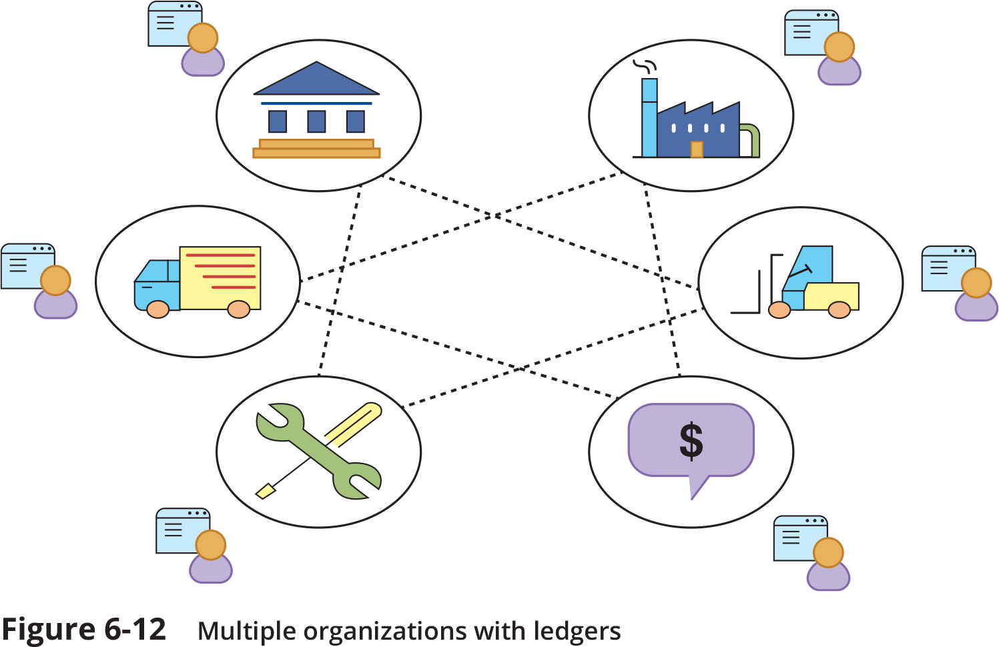
Blockchain (2 of 3)
Figure 6-12 Multiple organizations with ledgers

Slide 43
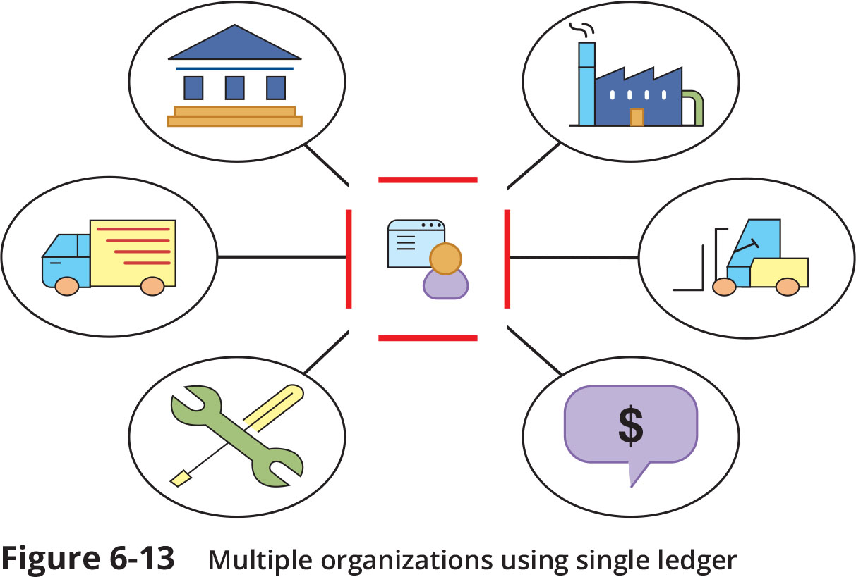
Blockchain (3 of 3)
Figure 6-13 Multiple organizations using single ledger

Slide 44
Knowledge Check Activity 4
Which of the following is an example of FDE?
a. BitLocker
b. EFS
c. GNuPG
d. Folder Lock

Slide 45
Knowledge Check Activity 4: Answer
Which of the following is an example of FDE?
Answer: a. BitLocker
BitLocker encrypts the entire system volume and prevents attackers from accessing data by booting from another OS. The other encryption methods encrypt individual files, folders, or transmitted data.

Slide 46
Self-Assessment
Complete Case Projects 6-2 and 6-3. After completing them, use your knowledge to consider these questions: What are the downsides to using encryption to secure your data on your own devices? How easy is it to encrypt your data and what are the possible consequences of not encrypting your data?

Slide 47
Summary (1 of 2)
Cryptography is the practice of transforming information into a secure form so that unauthorized persons cannot access it
Cryptography can provide confidentiality, integrity, authentication, nonrepudiation, and obfuscation
One variation of a cryptographic algorithm is based on the device that is used in the cryptographic process
Another variation is the amount of data that is processed at a time
Hashing creates a unique digital fingerprint called a digest, which represents the contents of the original material
Symmetric cryptography (also called private key cryptography) uses a single key to encrypt and decrypt a message

Slide 48
Summary (2 of 2)
Asymmetric cryptography (also known as public key cryptography) uses two keys instead of one
Because cryptography provides a high degree of protection, it remains under attack
Quantum computing relies on quantum physics using atomic-scale units (qubits) that can be both 0 and 1 at the same time
Cryptography can be applied through either software or hardware
Hardware encryption cannot be exploited like software cryptography
A blockchain is a shared, immutable ledger that facilitates the process of recording transactions and tracking assets in a business network

